Slide 1
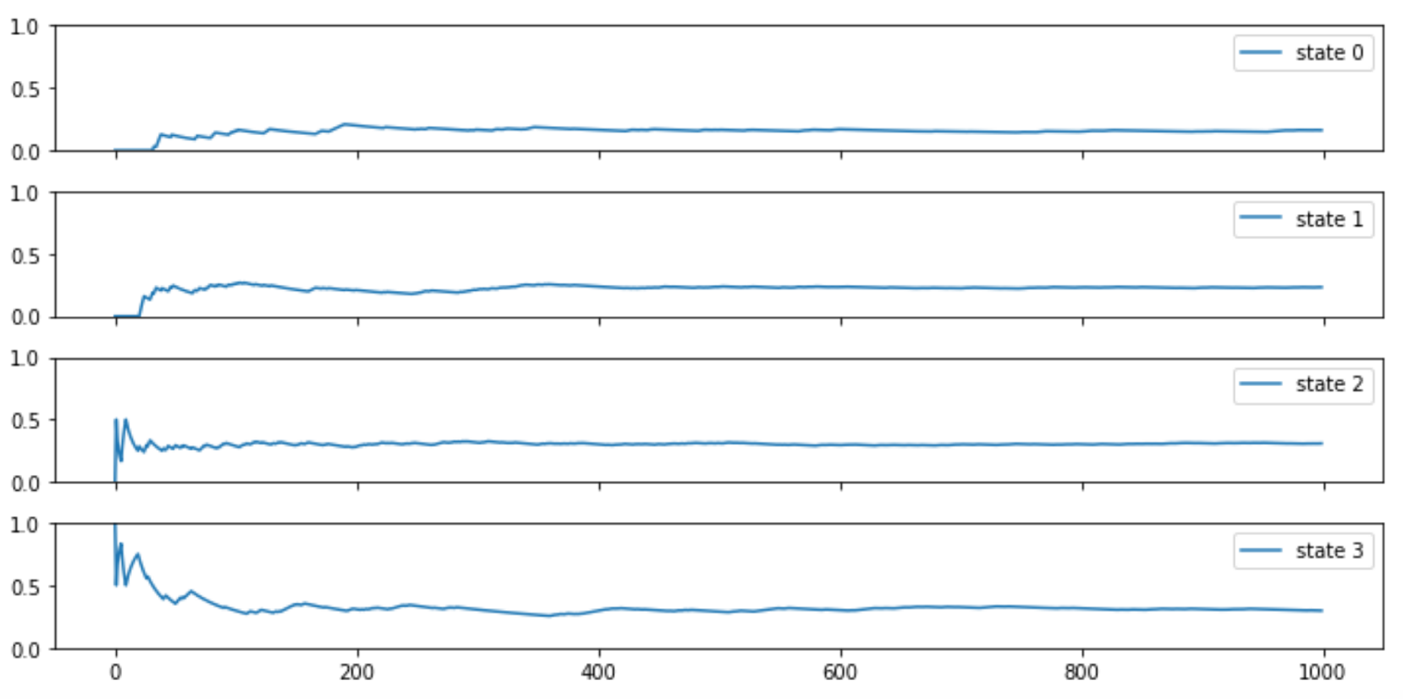
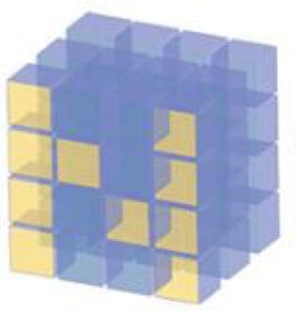
Markov Chain - Stationary Distribution

Slide 2
Reference
Youtube
Code

Slide 3
Stationary Distribution

Slide 4
Stationary Distribution

Slide 5
Stationary Distribution
PMF
on State Space

Slide 6
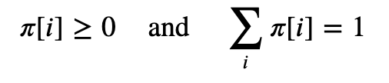
Stationary Distribution
PMF
on State Space

Slide 7
Stationary Distribution
No Change
over Time
PMF
on State Space

Slide 8

Stationary Distribution
No Change
over Time
PMF
on State Space

Slide 10
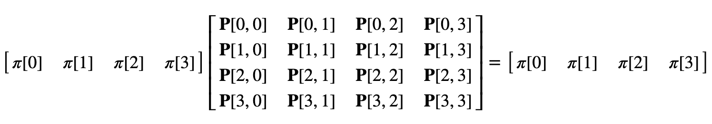

Slide 11
PMF
Today

Slide 12
PMF
Today
PMF
Tomorrow

Slide 13
How to Find
Stationary Distribution
using
Simulation

Slide 14
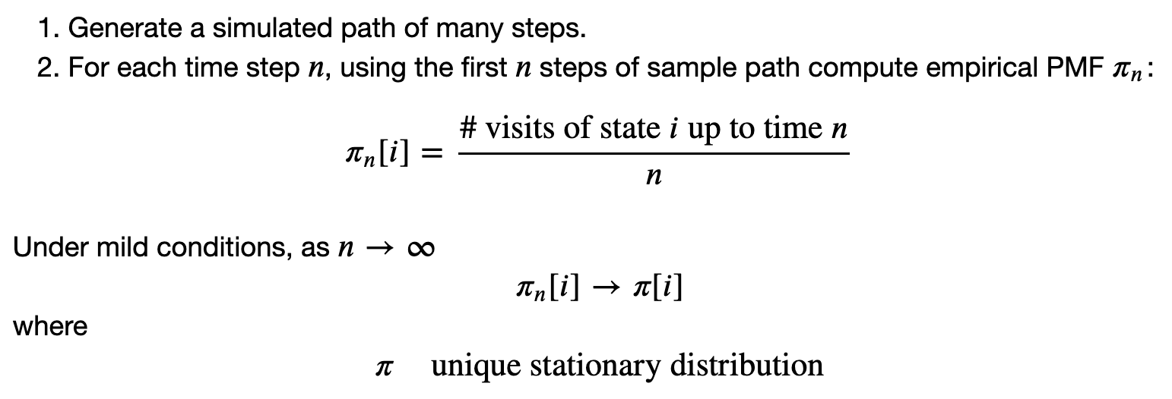

Slide 15

State

Slide 16
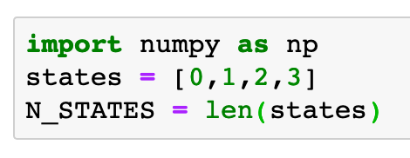
0
1
2
3

Slide 17

Transition Probability

Slide 18
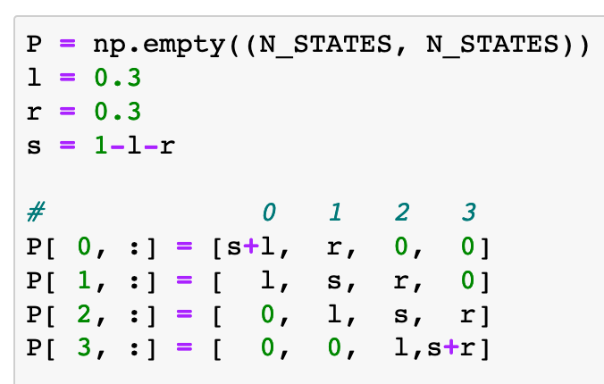
0.3
0.3
0.3
0
1
2
3
0.3
0.3
0.3
0.7
0.4
0.4
0.7

Slide 19
Initial State

Slide 20
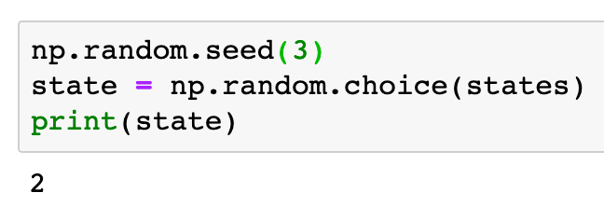
2

Slide 21
Stationary Distribution
using
Simulation

Slide 22
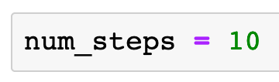

Slide 23
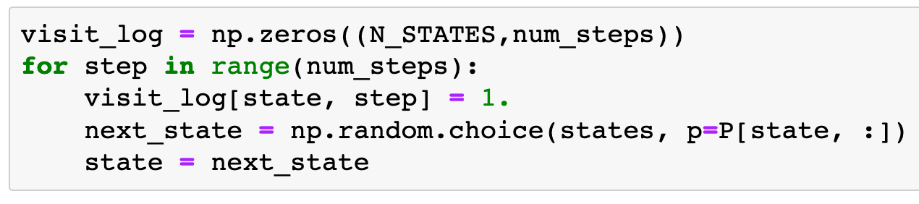

Slide 24
Record trajectory

Slide 25
Record trajectory
State

Slide 26
Record trajectory
State
Time

Slide 27
Record trajectory
State
Time
Record trajectory

Slide 28
Record trajectory
State
Time
Current State
Record trajectory

Slide 29
Record trajectory
State
Time
Current Time
Current State
Record trajectory

Slide 30
Record trajectory
State
Time
1.
Current Time
Current State
Record trajectory

Slide 31
Current State

Slide 32
Current State
Transition Probability

Slide 33
Current State
Transition Probability
Next State

Slide 34
Update Current State
Current State
Transition Probability
Next State

Slide 35
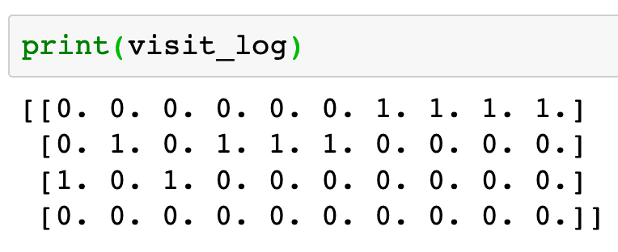

Slide 36
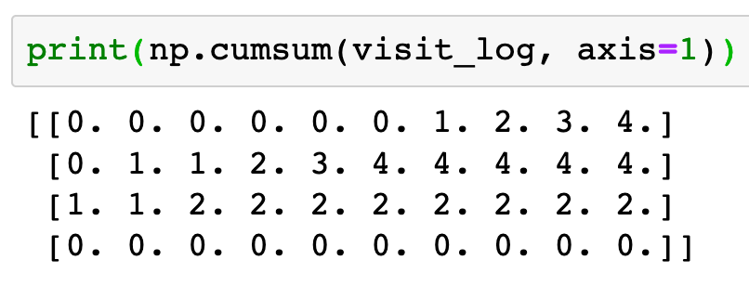

Slide 37
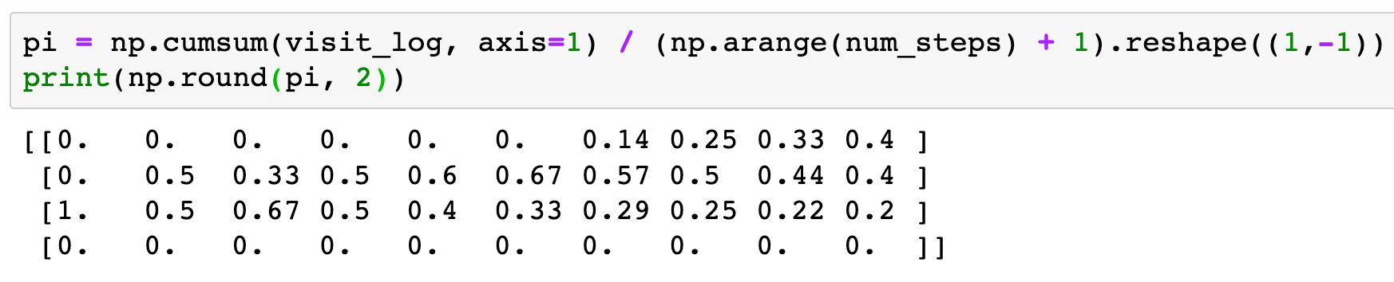

Slide 38
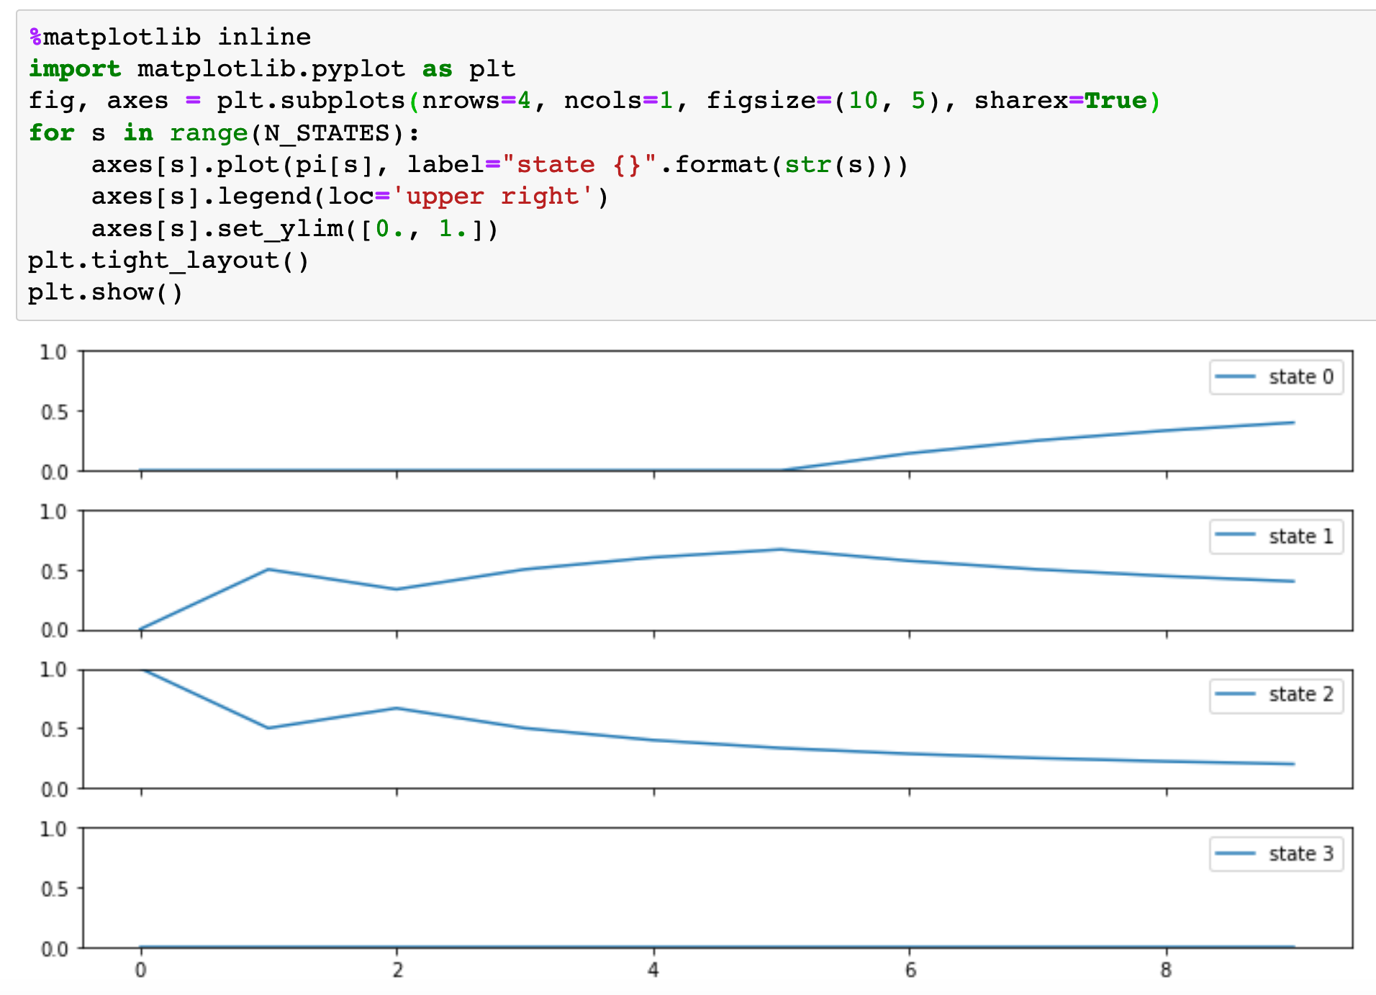

Slide 39
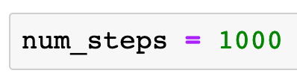

Slide 40
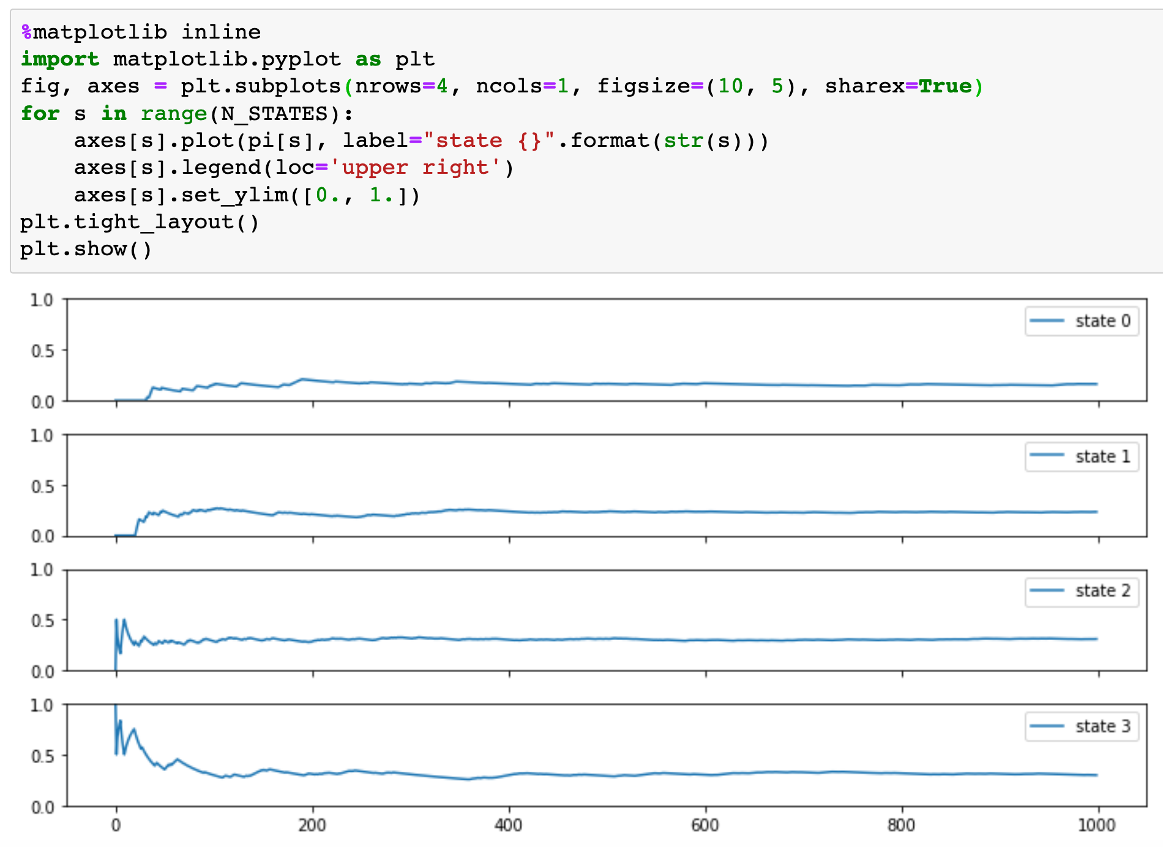

Slide 41
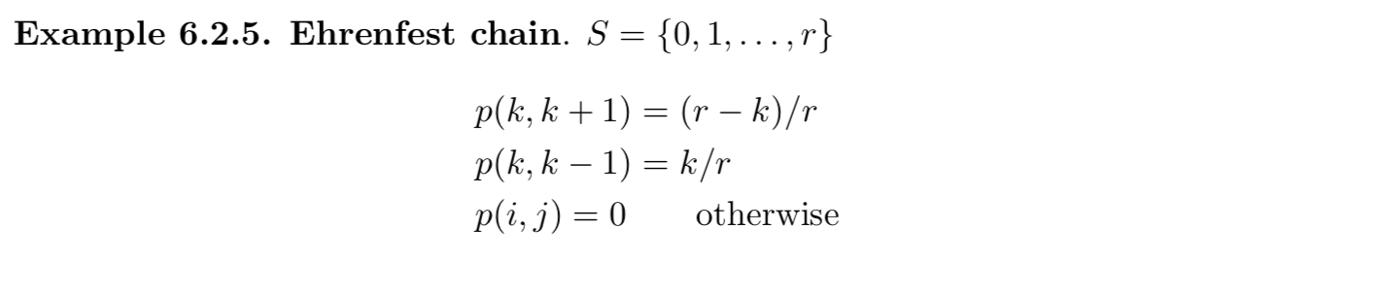
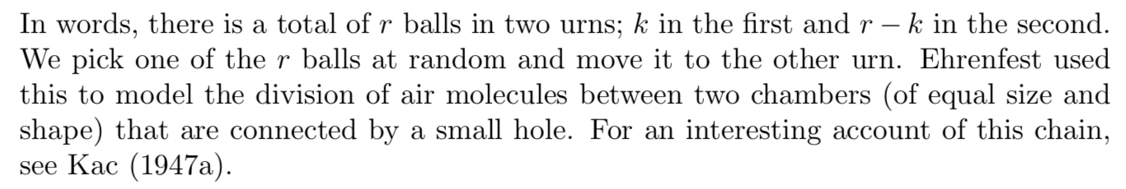
Exercise
1. Compute the stationary distribution of the following Markov Chain from
Durrett
with r=5
2. Compare the stationary distribution obtained from 1 with the one from simulation.

Slide 42
Now
Let’s Play with Code

